Slide 1

DriverPass System Analysis
Euntak Jang
Notes:
[No speaker notes required for this slide.]

Slide 2
System Requirements
Functional Requirements:
Driver Availability verify: The system should allow the user to verify the driver's availability status for a certain day and time. This need is critical since it allows the user to successfully organize their vacation.
Car Reservation: The system should enable the user to reserve a car for a certain day and time. This criteria is crucial since it is the foundation of a car rental business.
Non-Functional Requirements:
Speed: The system should be able to accommodate a large number of concurrent users without sacrificing speed. This is critical for ensuring a positive user experience at busy times.
Security: To protect the security of the user's data, the system should utilize robust data encryption and user authentication procedures. This criterion is critical because it safeguards users' personal and financial information from unwanted access or breaches.
Notes:
The functional requirements for DriverPass allow users to efficiently engage with the system for its intended application, which is checking driver availability and making car bookings. These are the basic system functions that every user would anticipate.
Nonfunctional requirements, on the other hand, assure the system's robustness, speed, and security. Given that DriverPass will have several users accessing the system at the same time, maintaining good performance is critical to ensure customer satisfaction. Furthermore, because users will be exchanging sensitive personal and financial information with the system, security must be prioritized in order to secure user data and develop user confidence.

Slide 3
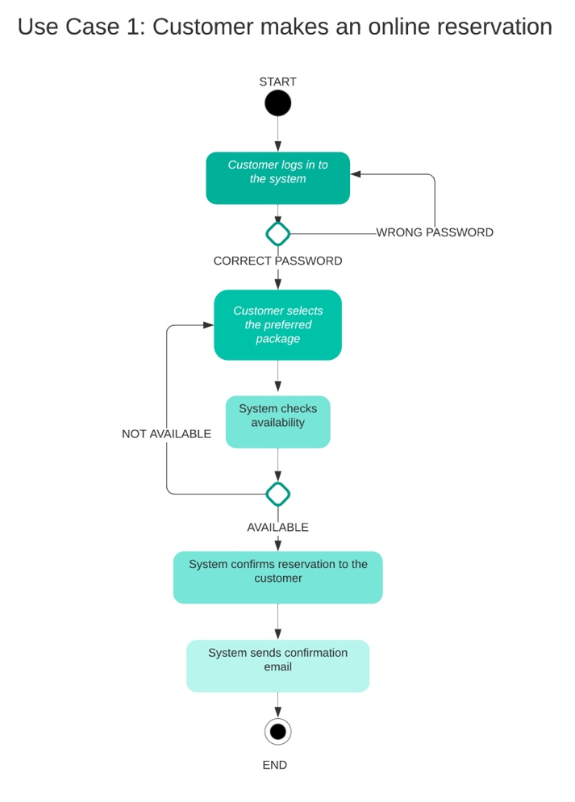
Use Case Diagram
Notes:
Assume you are a new client looking to reserve a car in Use Case 1. The interaction will look like this:
You would first create an account on the system as a new customer.
You then check for vehicles and drivers who are available on a given date and time.
You make a reservation once you've found a suitable vehicle.
The system verifies the availability of the selected automobile and driver.
Your reservation is confirmed if both are available.
The DriverPass technology is present throughout this procedure to make the entire operation smooth and user-friendly. We created the system to meet all of DriverPass's requirements, delivering an efficient car reservation service while also taking into consideration elements such as driver availability and varied consumer preferences.

Slide 4
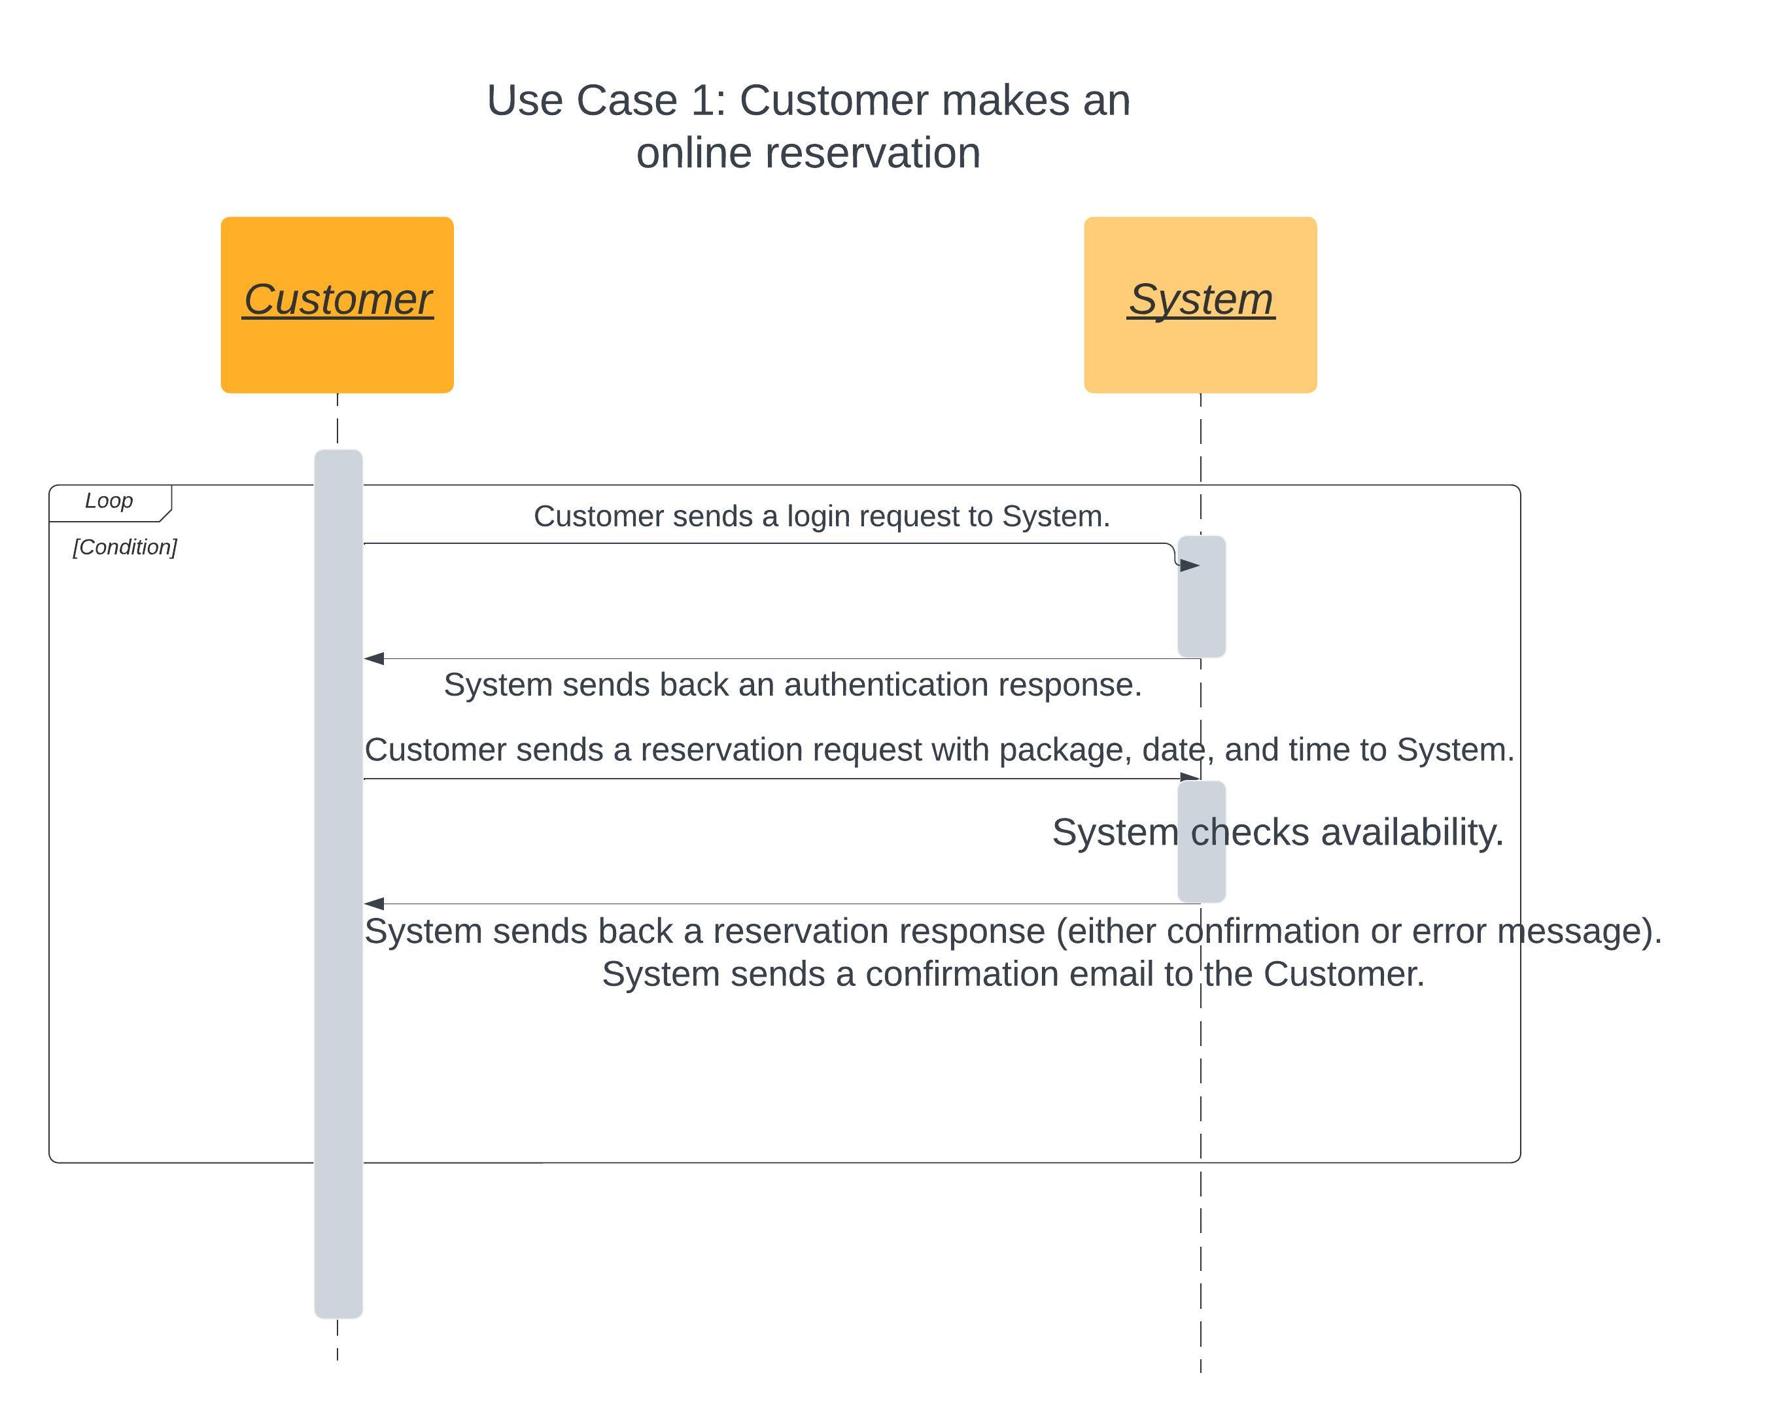
Activity Diagram
Notes:
Let's look at a scenario in which a customer wishes to reserve a car. This procedure is essential to the DriverPass system and demonstrates how the system caters to the demands of DriverPass.
Identifying the requirement: After logging into their DriverPass account, the consumer finds they need to hire a car.
Exploring the possibilities: Following that, the user may browse available automobiles and examine data such as the car's kind, condition, and more. They may also look at the various packages that are offered, which may include perks like as savings for longer rental periods, insurance choices, or unique automobiles.
After browsing, the consumer chooses on the vehicle they wish to hire. They also choose the rental length and any other booking parameters.
Making a Reservation: The consumer then reserves the vehicle. This includes defining the start time and date of the rental term, as well as where they want to pick up the automobile.
Confirmation: After a reservation is made, the system checks to see if the selected automobile is available for the time and place indicated. If this is the case, the reservation is confirmed and the customer is contacted. If it isn't, the buyer will be invited to choose another choice.
We evaluated DriverPass's desire to create a smooth, user-friendly experience for their consumers when building this use case. Every step, from a simple login through browsing and reservation to confirmation, is designed to be simple and intuitive, while providing the consumer with a wide range of alternatives to fulfill their individual needs. We omitted technical jargon to make this explanation accessible and simple for everyone.

Slide 5
Security
Secure Logins: To access their account, each user must generate a unique username and password. This helps to safeguard personal information and reservation information from unwanted access.
Data Encryption: Information provided by users, such as payment information, is not kept in a readable manner. It is turned into a code that only the system can read. Even if someone gained illegal access to the system, they would be unable to comprehend the data.
Secure Payments: We assure the security of all payments made through the DriverPass system. We collaborate with reliable payment processors who employ cutting-edge technologies to prevent fraudulent transactions.
DriverPass is updated on a regular basis to handle any new possible security issues. These updates serve to keep the system safe and running smoothly.
We have a clear privacy policy that defines how we collect, handle, and safeguard user data. This is critical for ensuring that users understand their rights and how their data is managed.
Monitoring and Alerts: Our system is continually on the lookout for unusual behavior. If the system detects something strange, such as several failed login attempts, it sends a warning and can temporarily lock the account to safeguard it from potential threats.
Notes:
By taking these security issues into account, we hope to create a system that not only delivers an amazing user experience but also gives every user piece of mind in knowing their information is secure.

Slide 6
System Limitations
DriverPass is an online system that requires a consistent internet connection to function. Users who live in places with low or no internet connectivity may have difficulty using the service.
Hardware Dependence: Our system's performance may be affected by the user's device and its capabilities. Older or lower-specified devices may encounter slower load times or issues operating more resource-intensive aspects of the system.
While we strive for intuitive design, some users may find the system difficult to operate at first. We alleviate this by offering user assistance and help materials, although there may still be a learning curve at first.
Maintenance & Downtime: As with any online system, maintenance or updates to the system may cause brief downtime. While we attempt to schedule these during off-peak hours and offer sufficient notice, some users may be inconvenienced.
Limited Customization: While we attempted to meet the majority of user requirements, the solution may not cover all conceivable use cases. This version may have less customization possibilities for particular user preferences.
Notes:
Recognizing these constraints allows us to improve on them in future updates and innovations, aiming for a system that meets as many user demands as feasible.

